Slide 1

Medium Access Control (MAC)

Slide 2
The medium access control (MAC) is a sublayer of the data link layer of the open system interconnections (OSI) reference model for data transmission.
It is responsible for flow control and multiplexing for transmission medium.
It controls the transmission of data packets via remotely shared channels.
It sends data over the network interface card(NIC).

Slide 3
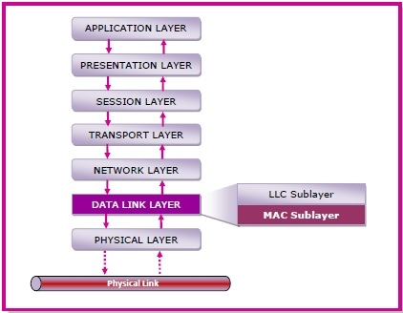
MAC Layer in the OSI Model
The Open System Interconnections (OSI) model is a layered networking framework that conceptualizes how communications should be done between heterogeneous systems. The data link layer is the second lowest layer. It is divided into two sublayers −
The logical link control (LLC) sublayer
The medium access control (MAC) sublayer

Slide 4
Functions of MAC Layer
It provides an abstraction of the physical layer to the LLC and upper layers of the OSI network.
It is responsible for encapsulating frames so that they are suitable for transmission via the physical medium.
It resolves the addressing of source station as well as the destination station, or groups of destination stations.
It performs multiple access resolutions when more than one data frame is to be transmitted. It determines the channel access methods for transmission.
It also performs collision resolution and initiating retransmission in case of collisions.
It generates the frame check sequences and thus contributes to protection against transmission errors.

Slide 5
MAC Addresses
MAC address or media access control address is a unique identifier allotted to a network interface controller (NIC) of a device.
It is used as a network address for data transmission within a network segment like Ethernet, Wi-Fi, and Bluetooth.
MAC address is assigned to a network adapter at the time of manufacturing. It is hardwired or hard-coded in the network interface card (NIC).
A MAC address comprises of six groups of two hexadecimal digits, separated by hyphens, colons, or no separators.
An example of a MAC address is 00:0A:89:5B:F0:11.

Slide 6
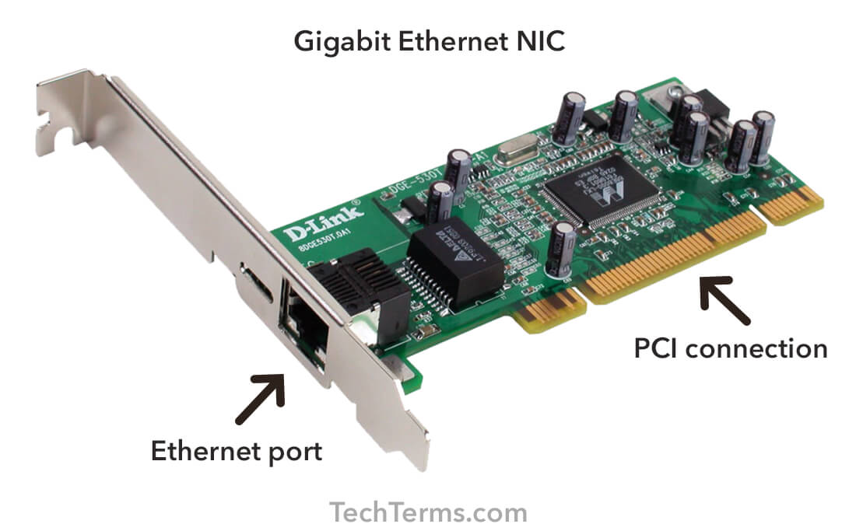

Slide 7
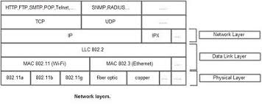

Slide 8
logical link control (LLC)
The logical link control (LLC) is the upper sublayer of the data link layer of the open system interconnections (OSI) reference model for data transmission. It acts act an interface between the network layer and the medium access control (MAC) sublayer of the data link layer.
The LLC sublayer is mainly used for its multiplexing property. It allows several network protocols to operate simultaneously within a multipoint network over the same network medium.
Functions of LLC Sublayer
The primary function of LLC is to multiplex protocols over the MAC layer while transmitting and likewise to de-multiplex the protocols while receiving.
LLC provides hop-to-hop flow and error control.
It allows multipoint communication over computer network.
Frame Sequence Numbers are assigned by LLC.
In case of acknowledged services, it tracks acknowledgements

Slide 9
Ethernet CSMA/CD
Carrier-sense multiple access with collision detection (CSMA/CD) is a media access control (MAC) method used most notably in early Ethernet technology for local area networking.
It uses carrier-sensing to defer transmissions until no other stations are transmitting.
when a device is ready it senses the network whether there is an ongoing transmission or not.
if there is no transmission is going on it starts transmitting. If there is a transmission going it waits for the channel to get free .
Now if by any means a collision occurs a jam signal is sent to all the devices now the devices wait for some time to retransmit but still if collision occurs 15 times the nodes transmitting will time out and after that every node will have equal probability of transmission

Slide 10
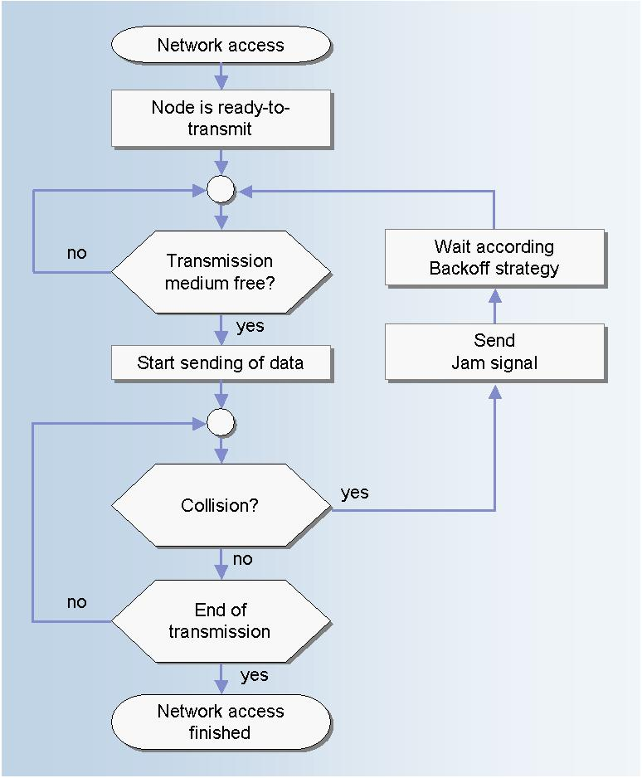
Flow Diagram

Slide 11
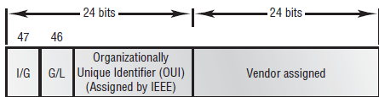
Now how addressing takes place in ETHERNET
The addressing in Ethernet takes place with MAC(medium access control) It is a 6 byte long or 48 bits. This address is of the physical Ethernet card or NIC(network information card ) which is installed on a system. This is called physical address as this address is programmed into the chip of network card.
The initial 24 bits are for the Vendor which identifies that the card was manufactured by which vendor.

Slide 12
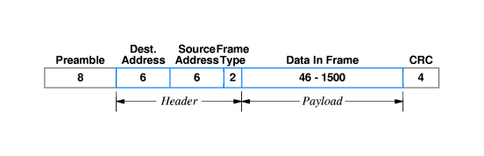
The Ethernet frame
The 64-bit preamble consists of alternating ones and zeros allowing the receiver to synchronise with the incoming signal.
This is followed by the header consisting of a 48-bit destination address, a 48-bit source address, and a 16-bit frame type.
The payload can vary in length from a minimum of 46 octets to a maximum of 1,500 octets. This is followed by a 32-bit CRC

Slide 13
Token Ring
Token Ring is a computer networking technology used to build local area networks.
It uses a special three-byte frame called a token that travels around a logical ring of workstations or servers.
or
Token ring (IEEE 802.5) is a communication protocol in a local area network (LAN) where all stations are connected in a ring topology and pass one or more tokens for channel acquisition.
A token is a special frame of 3 bytes that circulates along the ring of stations.
A station can send data frames only if it holds a token.
The tokens are released on successful receipt of the data frame.

Slide 14
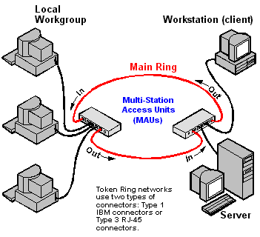

Slide 15
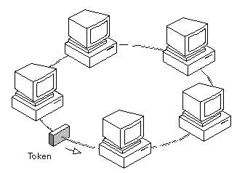
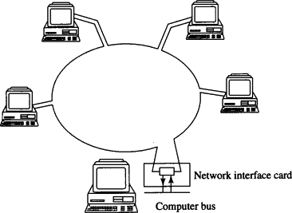
A type of computer network in which all the computers are arranged (schematically) in a circle.
A token, which is a special bit pattern, travels around the circle.
To send a message, a computer catches the token, attaches a message to it, and then lets it continue to travel around the network

Slide 16
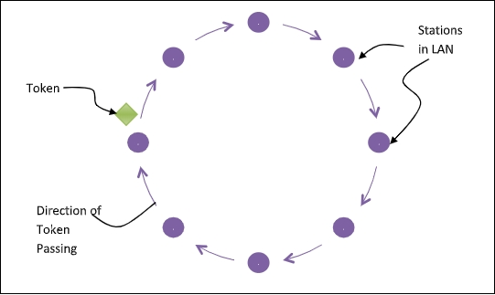
Token Passing Mechanism in Token Ring
If a station has a frame to transmit when it receives a token, it sends the frame and then passes the token to the next station; otherwise it simply passes the token to the next station.
Passing the token means receiving the token from the preceding station and transmitting to the successor station.
The data flow is unidirectional in the direction of the token passing. In order that tokens are not circulated infinitely, they are removed from the network once their purpose is completed.

Slide 17
Fiber Distributed Data Interface (FDDI)
Fiber Distributed Data Interface (FDDI) is a set of American National Standards Institute(ANSI) and ISO standards for transmission of data in local area network (LAN) over fiber optic cables.
It is applicable in large LANs that can extend up to 200 kilometers in diameter.

Slide 18
Features
FDDI uses optical fiber as its physical medium.
It operates in the physical and medium access control (MAC layer) of the Open Systems Interconnection (OSI) network model.
It provides high data rate of 100 Mbps and can support thousands of users.
It is used in LANs up to 200 kilometers for long distance voice and multimedia communication.
It uses ring based token passing mechanism and is derived from IEEE 802.4 token bus standard.
It contains two token rings, a primary ring for data and token transmission and a secondary ring that provides backup if the primary ring fails.
FDDI technology can also be used as a backbone for a wide area network (WAN).

Slide 19
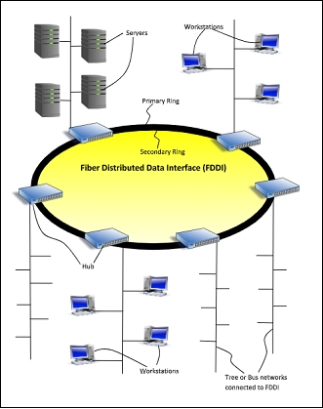
Diagram

Slide 20
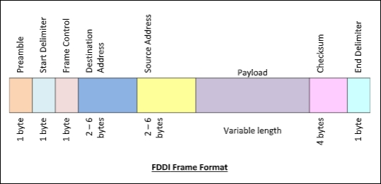
Frame Format

Slide 21
The fields of an FDDI frame are −
Preamble: 1 byte for synchronization.
Start Delimiter: 1 byte that marks the beginning of the frame.
Frame Control: 1 byte that specifies whether this is a data frame or control frame.
Destination Address: 2-6 bytes that specifies address of destination station.
Source Address: 2-6 bytes that specifies address of source station.
Payload: A variable length field that carries the data from the network layer.
Checksum: 4 bytes frame check sequence for error detection.
End Delimiter: 1 byte that marks the end of the frame.

Slide 22
Advantages of FDDI
Fiber optic cables transmit signals over more noteworthy separations of approximately 200 km.
It is conceivable to supply the need to the work stations associated within the chain. Consequently based on the prerequisite a few stations are bypassed to supply speedier benefit to the rest.
FDDI employments different tokens to make strides organize speed.
It offers a higher transmission capacity (up to 250 Gbps). Thus it can handle information rates up to 100 Mbps.
It offers tall security because it is troublesome to spy on the fiber-optic link.
Fiber optic cable does not break as effectively as other sorts of cables.
Disadvantages of FDDI
FDDI is complex. Thus establishment and support require incredible bargain of expertize.
FDDI is expensive. Typically since fiber optic cable, connectors and concentrators are exceptionally costly.

Slide 23
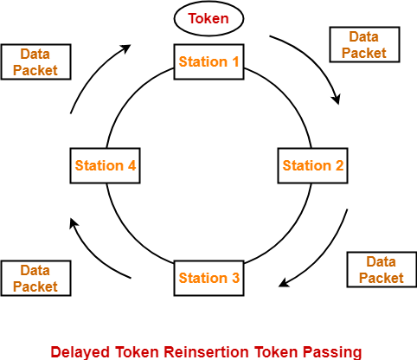
Token Passing
On a local area network, token passing is a channel access method where a signal called a token is passed between nodes to authorize that node to communicate

Slide 24
Token passing uses a token, or series of bits, to grant a device permission to transmit over the network.
Whichever device has the token can put data into the network. When its transmission is complete, the device passes the token along to the next device in the topology.
System rules in the protocol specifications mandate how long a device may keep the token, how long it can transmit for and how to generate a new token if there isn't one circulating.

Slide 25
Wireless LAN
Wireless LANs are those Local Area Networks that use high frequency radio waves instead of cables for connecting the devices in LAN.
Users connected by WLANs can move around within the area of network coverage such as home, school, campus, office building, railway platform, etc..
Most WLANs are based upon the standard IEEE 802.11 or WiFi.

Slide 26
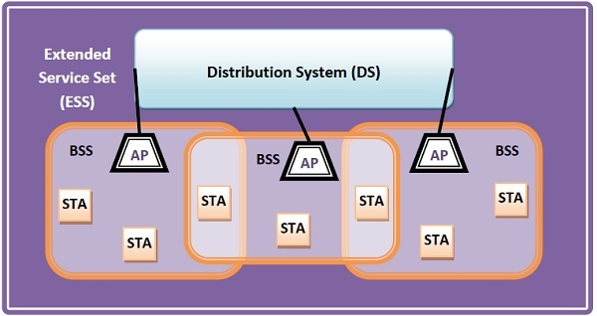
Components of WLANs
The components of WLAN architecture as laid down in IEEE 802.11 are −
Stations (STA)
Basic Service Set (BSS)
Extended Service Set (ESS)
Distribution System (DS)

Slide 27
Stations (STA) − Stations comprises of all devices and equipment that are connected to the wireless LAN. Each station has a wireless network interface controller. A station can be of two types −
Wireless Access Point (WAP or AP)
Client
Basic Service Set (BSS) − A basic service set is a group of stations communicating at the physical layer level. BSS can be of two categories −
Infrastructure BSS
Independent BSS
Extended Service Set (ESS) − It is a set of all connected BSS.
Distribution System (DS) − It connects access points in ESS.

Slide 28
Types of WLANS
WLANs, as standardized by IEEE 802.11, operates in two basic modes, infrastructure, and ad hoc mode.
Infrastructure Mode − Mobile devices or clients connect to an access point (AP) that in turn connects via a bridge to the LAN or Internet. The client transmits frames to other clients via the AP.
Ad Hoc Mode − Clients transmit frames directly to each other in a peer-to-peer fashion.

Slide 29
Advantages of WLANs
They provide clutter-free homes, offices and other networked places.
The LANs are scalable in nature, i.e. devices may be added or removed from the network at greater ease than wired LANs.
The system is portable within the network coverage. Access to the network is not bounded by the length of the cables.
Installation and setup are much easier than wired counterparts.
The equipment and setup costs are reduced.
Disadvantages of WLANs
Since radio waves are used for communications, the signals are noisier with more interference from nearby systems.
Greater care is needed for encrypting information. Also, they are more prone to errors. So, they require greater bandwidth than the wired LANs.
WLANs are slower than wired LANs.

Slide 30
Carrier-sense multiple access with collision avoidance (CSMA/CA)
Carrier Sense Multiple Access with Collision Avoidance (CSMA/CA) is a network protocol for carrier transmission that operates in the Medium Access Control (MAC) layer.
In contrast to CSMA/CD (Carrier Sense Multiple Access/Collision Detection) that deals with collisions after their occurrence, CSMA/CA prevents collisions prior to their occurrence.

Slide 31
Algorithm
When a frame is ready, the transmitting station checks whether the channel is idle or busy.
If the channel is busy, the station waits until the channel becomes idle.
If the channel is idle, the station waits for an Inter-frame gap (IFG) amount of time and then sends the frame.
After sending the frame, it sets a timer.
The station then waits for acknowledgement from the receiver. If it receives the acknowledgement before expiry of timer, it marks a successful transmission.
Otherwise, it waits for a back-off time period and restarts the algorithm.

Slide 32
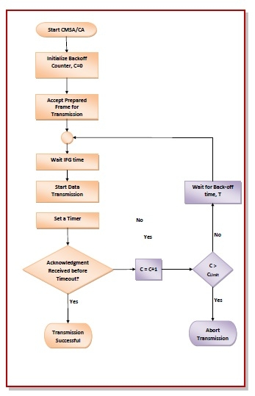
Flowchart

Slide 33
Advantages of CMSA/CD
CMSA/CA prevents collision.
Due to acknowledgements, data is not lost unnecessarily.
It avoids wasteful transmission.
It is very much suited for wireless transmissions.
Disadvantages of CSMA/CD
The algorithm calls for long waiting times.
It has high power consumption.

